Slide 1

Def Week2_mini_project(code,
By=”Henri Vandersleyen”):

Slide 2
Problem to solve
build the database of restaurants, bars and various points of interest (POIs) in the area of your choice and find out which API has better coverage in the selected area

Slide 3
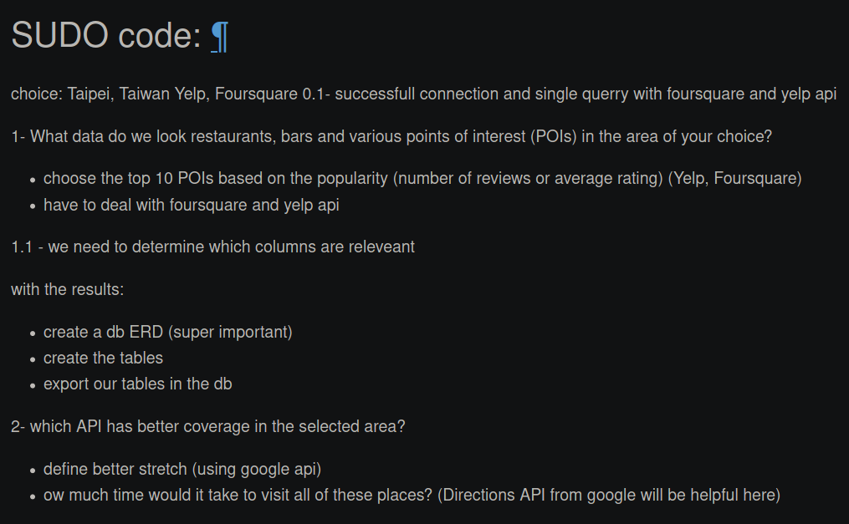

Slide 4
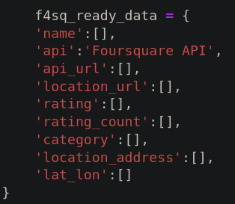
Data Sought for our SQL
Not all the info received was important and so I wanted the following data whether it was given by the API or not.

Slide 5
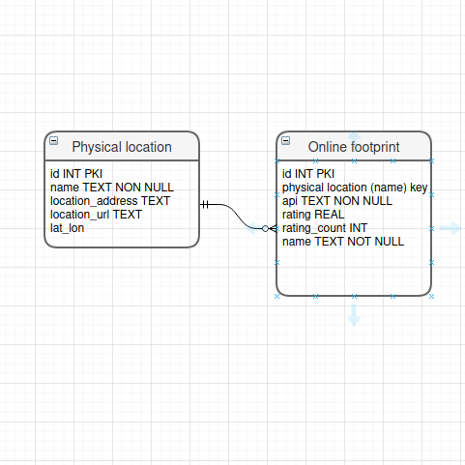
SQL ERD
One “physical location” (e.g restaurants/bars/etc) can have multiple “online footprint”(Yelp/4sq/google etc.).

Slide 6
foreshadowing
Since all the interactions are done by the developer, Foursquare is the better API due to the 2 step data pull process and the subsequent detailed response. I haven’t been able to confirm the accuracy.
But, further development may yield a different conclusion.

Slide 7
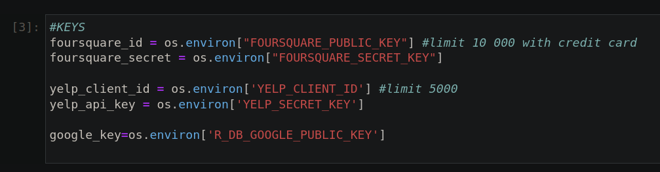

Slide 8
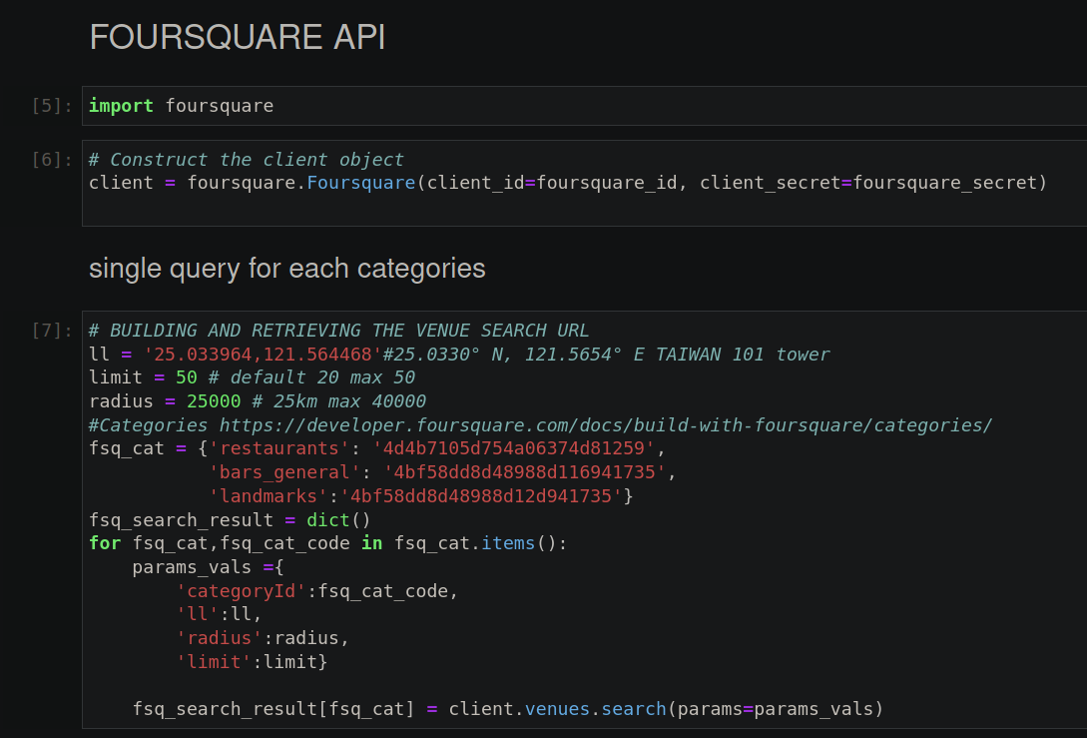
4square request

Slide 9
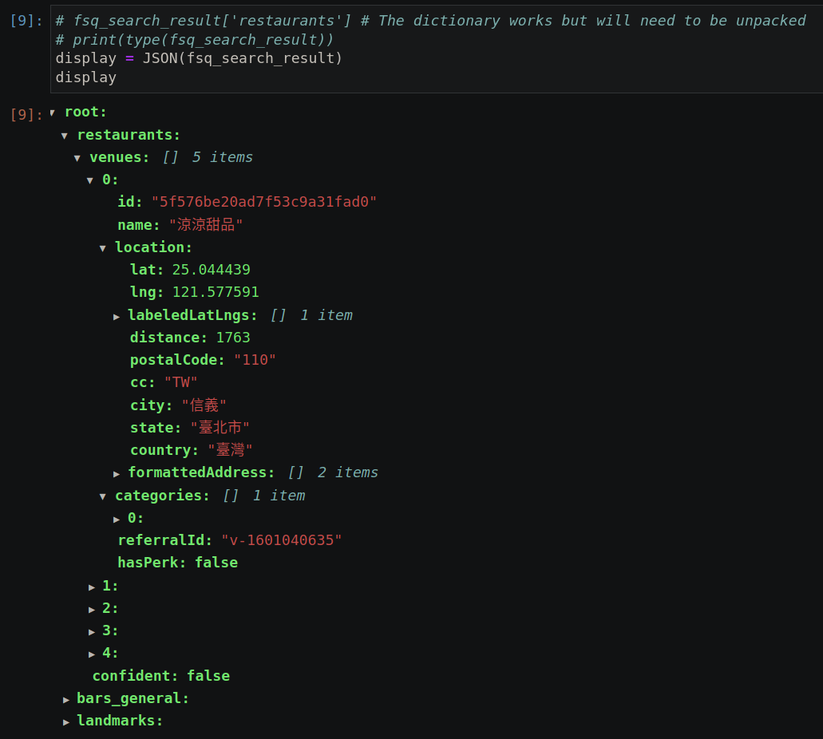
JSON structure of 4square

Slide 10
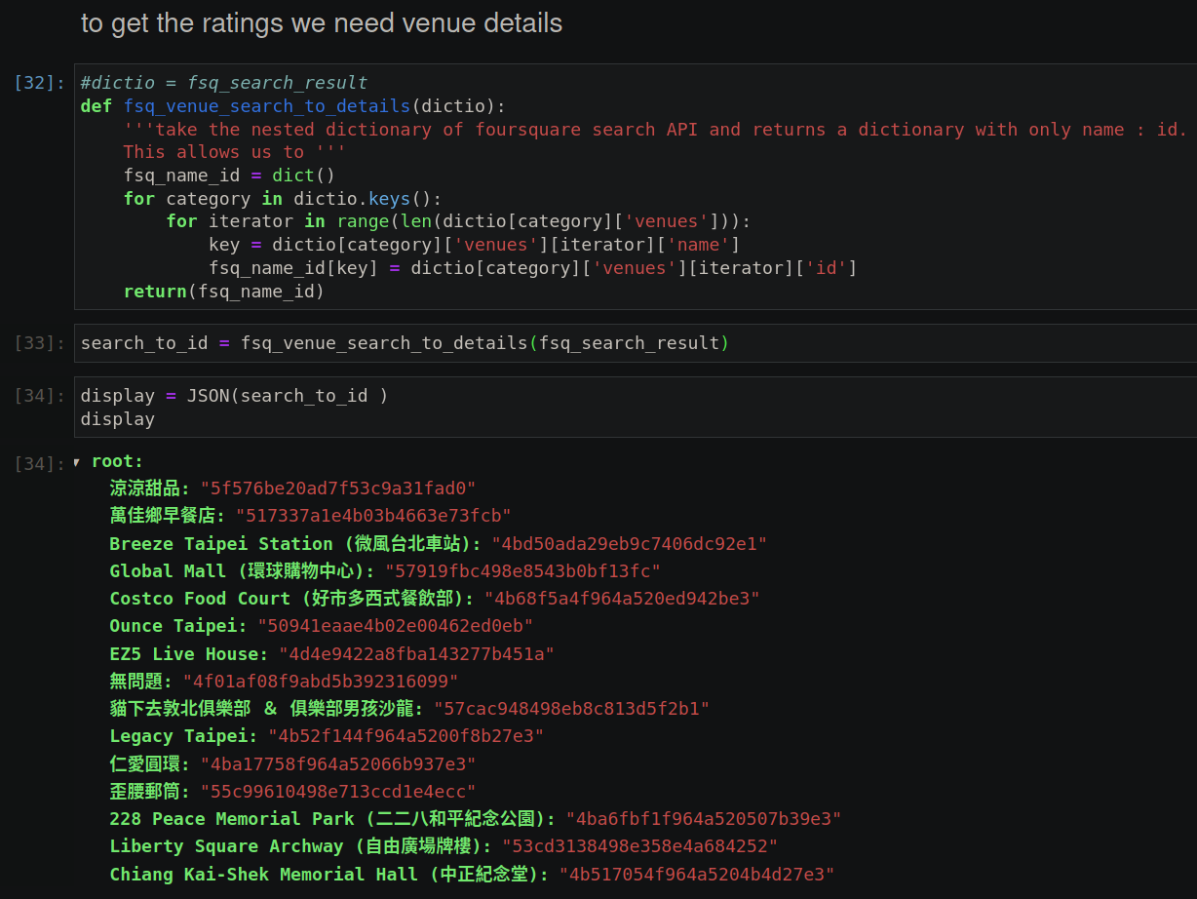
4square venue ID preparation

Slide 11
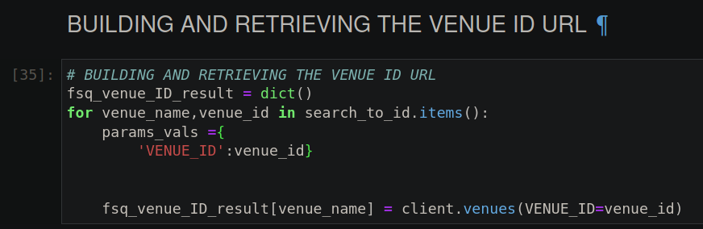
4square venue ID query

Slide 12
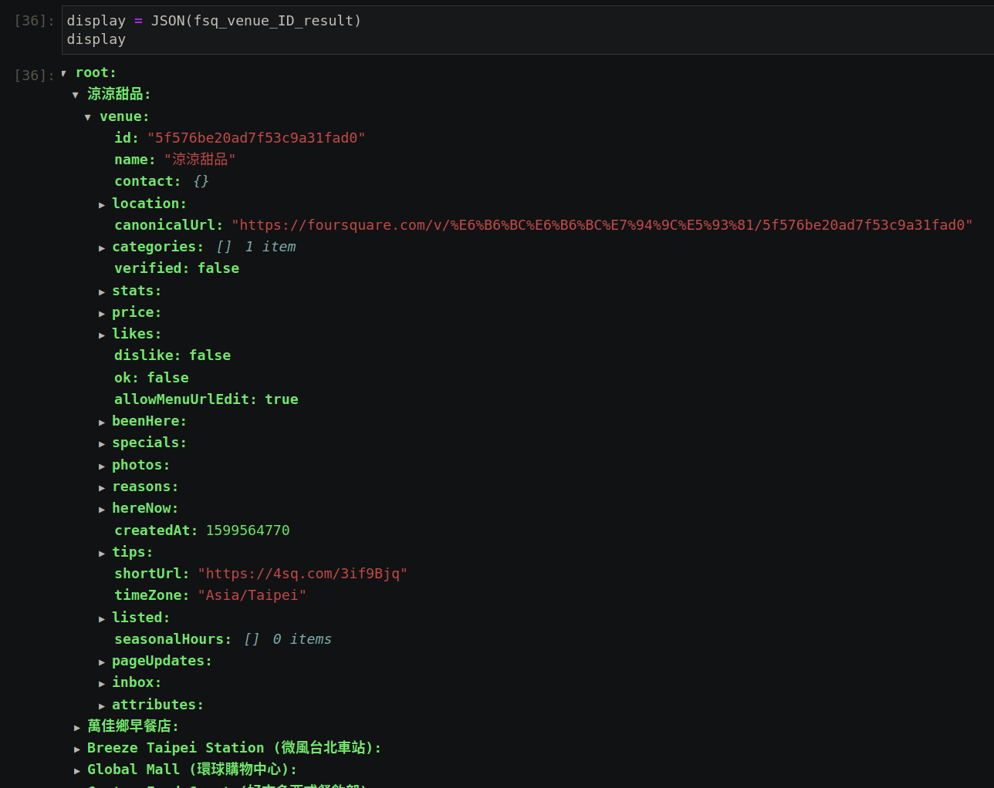
4square venue ID JSON structure

Slide 13
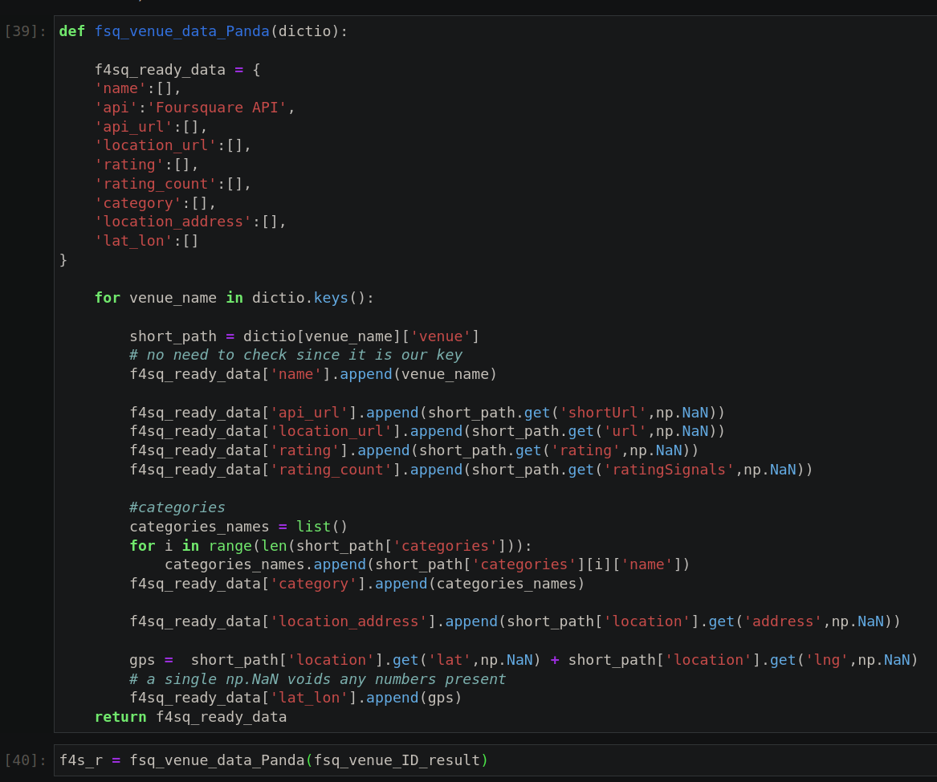
4square data extraction/polishing

Slide 14
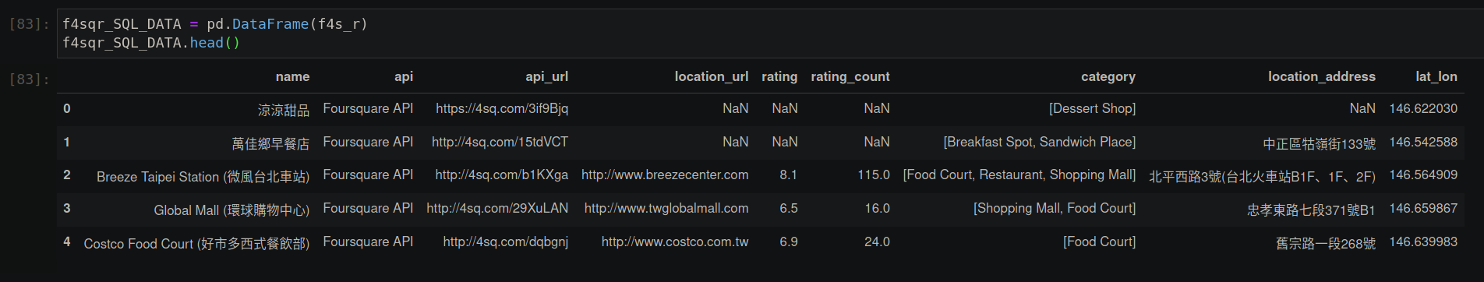
4square resulting pandas.DF

Slide 15
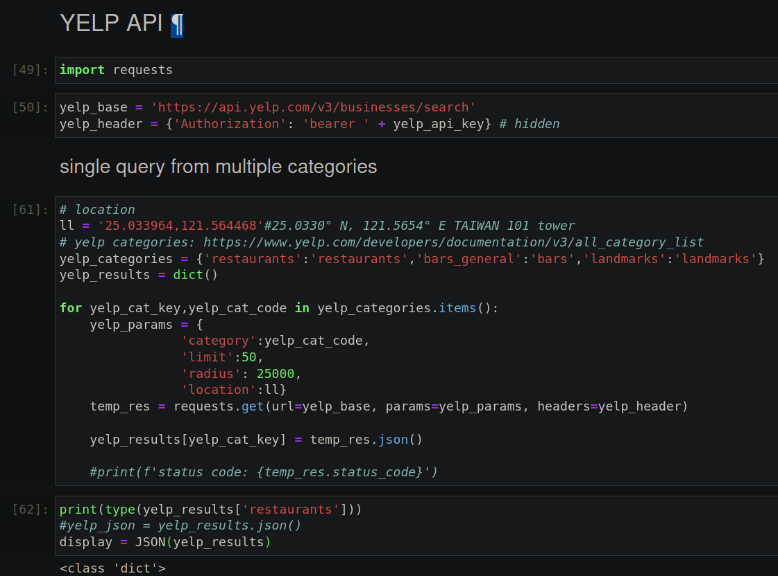
Yelp Query

Slide 16
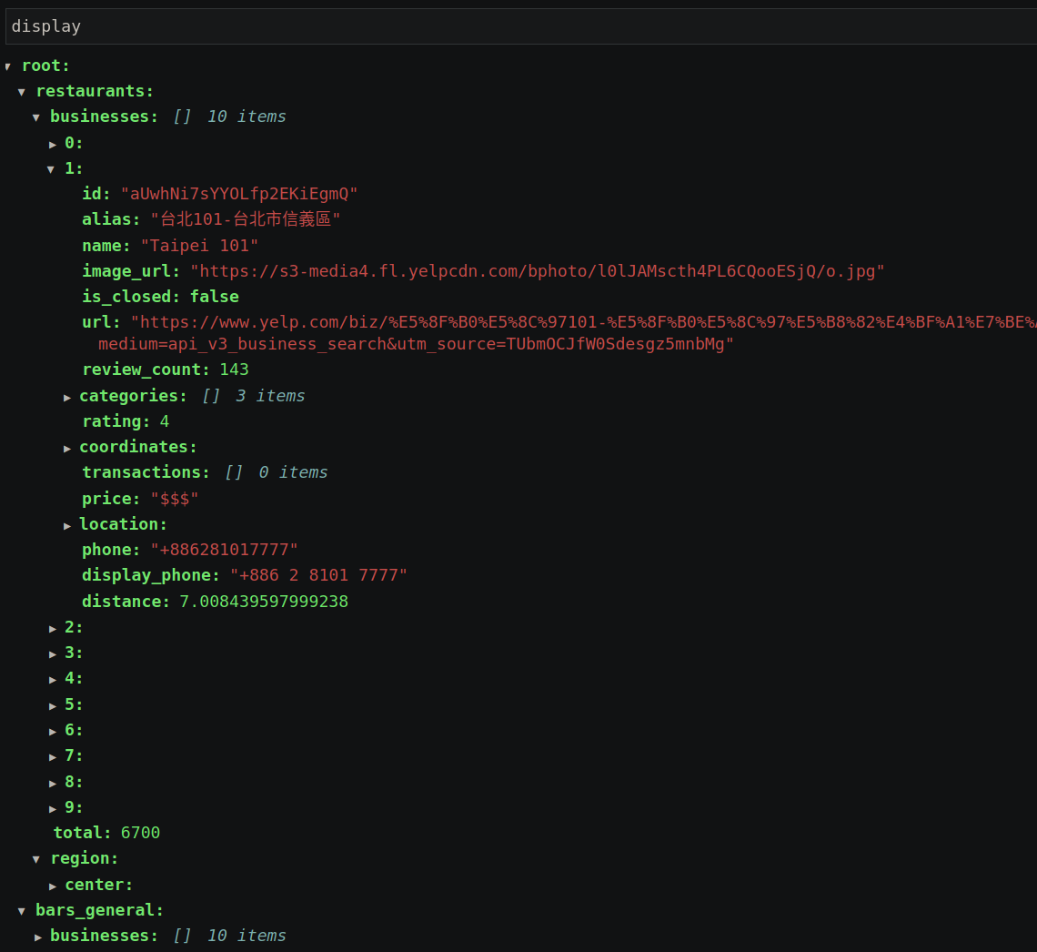
Yelp results JSON

Slide 17
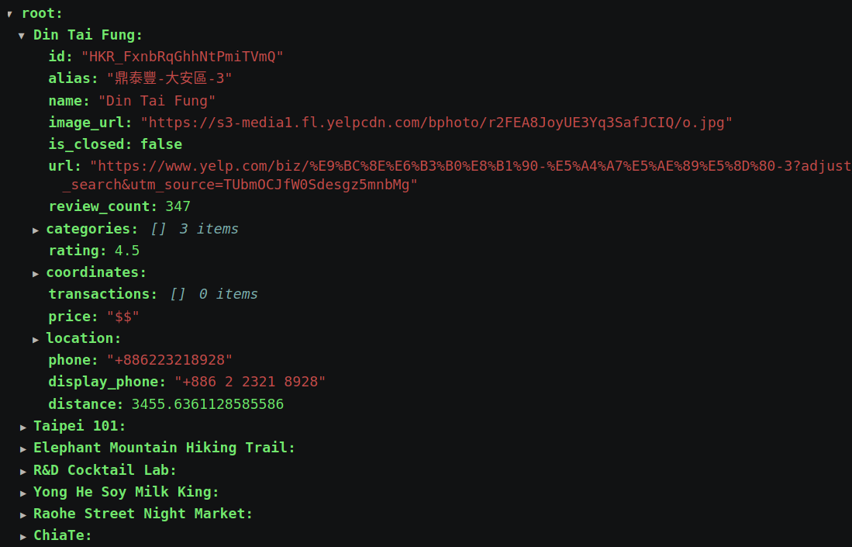
Yelp normalized results JSON

Slide 18
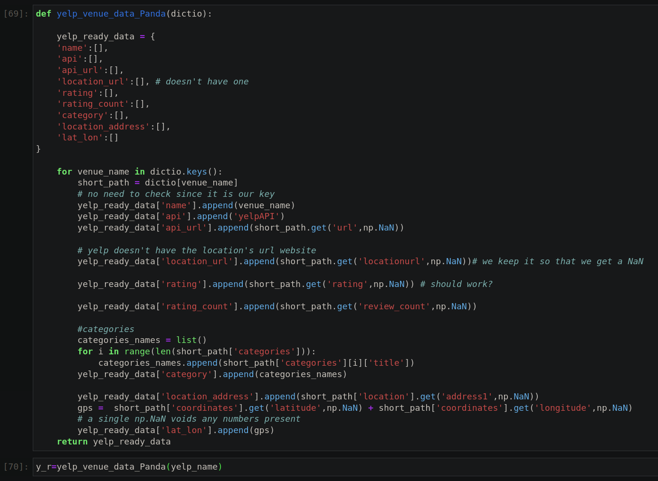
Yelp data extraction polishing

Slide 19
Yelp data extraction polishing

Slide 20
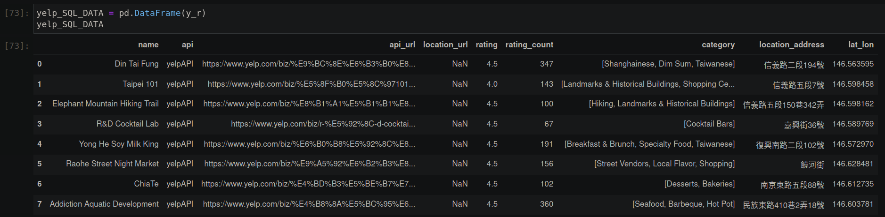
Yelp pd.DataFrame

Slide 21
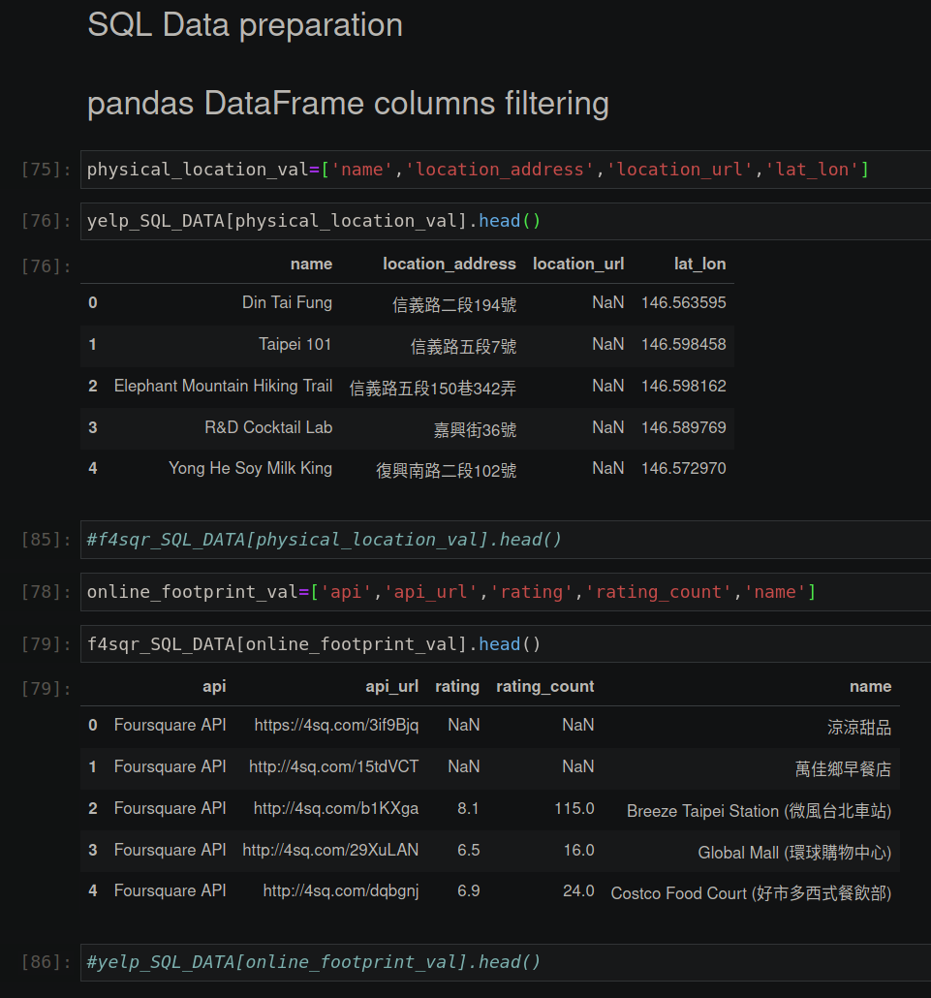

Slide 22
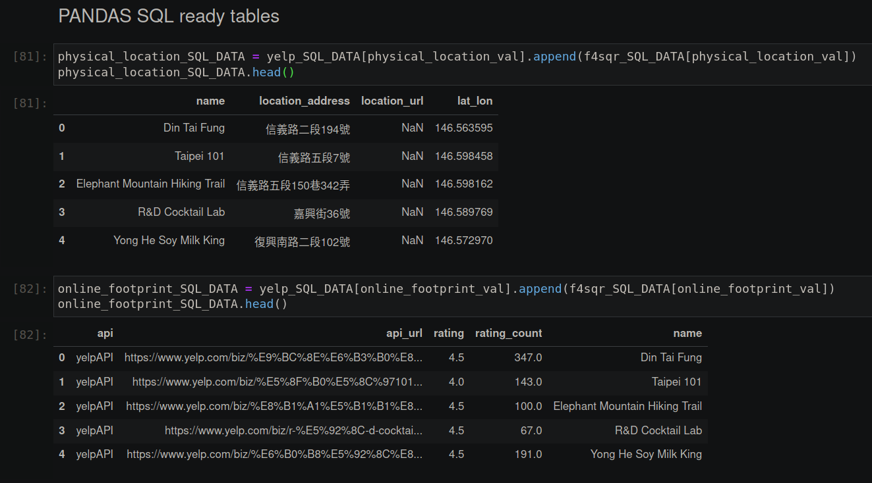

Slide 23
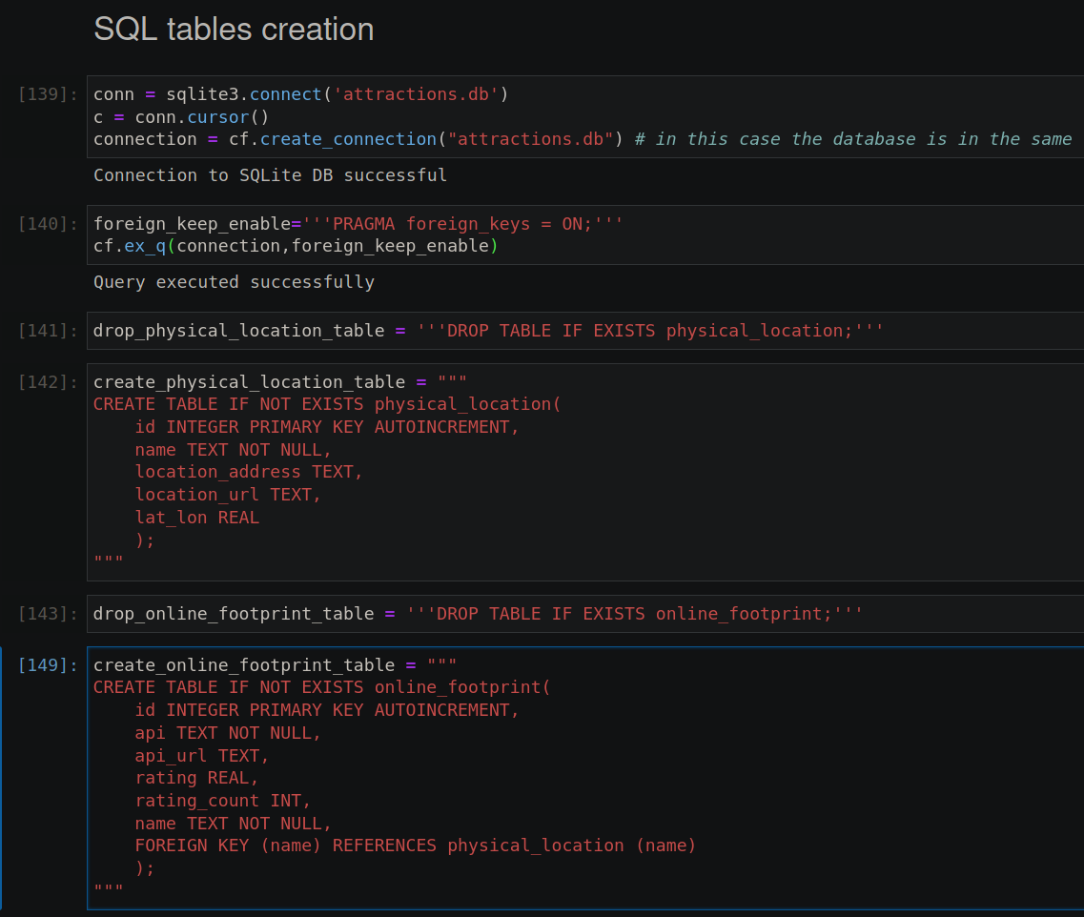

Slide 24
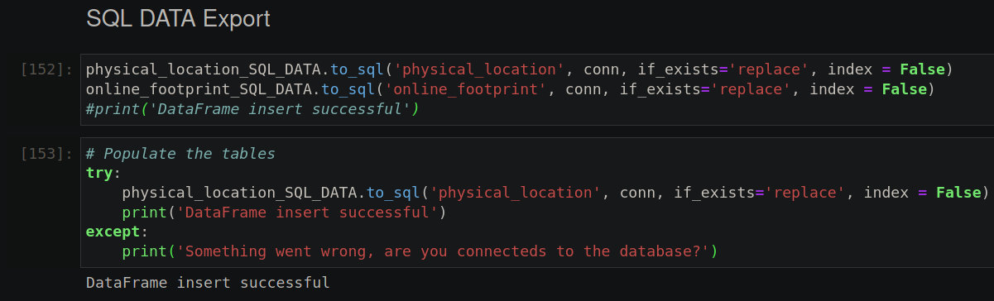

Slide 25
Issues
- SQL foreign keys do not work
- my sql connections must be reworked
- Yelp API seems to return the same results, regardless of categories
- Yelp normalization could have been handled better
- Normalizing the data through Pandas is the end goal
-Since both APIs returns physical location names differently I should use lat_lon (which the same degree of precision) as the foreign key. This is a problem for the DB where all we don’t want copies.

Slide 26
